Slide 1
SUBOXONE
OFFICE BASED ADDICTION TREATMENT
KISHORE THAMPY MD

Slide 2
OBJECTIVES
UNDERSTAND THE EXTENT OF THE ADDICTION OPIATE PROBLEM
BECOME AWARE OF THE LEGAL HISTORY OF SUBOXONE
IDENTIFY CANDIDATES FOR OFFICE BASED OPIOD TREATMENT
UNDERSTAND APPROPRIATE USE OF SUBOXONE AND POTENTIAL PITFALLS

Slide 3
ADDICTION EPIDEMIOLOGY: Nora D. Volkow, M.D. Senate Caucus on International Narcotics Control 2014
Between 26.4 million and 36 million people abuse opioids worldwide
2.1 million people in the United States
467,000 addicted to heroin
unintentional overdose deaths from prescription pain relievers has soared in the United States, more than quadrupling since 1999.
increased non-medical use of opioid analgesics and heroin abuse in the United States.
number of prescriptions for opioids have escalated from around 76 million in 1991 to nearly 207 million in 2013

Slide 4
OPIOID USE IN THE USA
USA accounts for 100% of all Oxycodone use and 81% of Hydrocodone use in the world
emergency department visits involving nonmedical use of opioid analgesics increased from 144,600 in 2004 to 305,900 in 2008
overdose deaths due to prescription opioid pain relievers have more than tripled in the past 20 years, escalating to 16,651 deaths in the United States in 2010.
1 million veterans on opioids, 9266 in NFSG
50% are chronic users i.e.dependent
1/3 of all veteran suicides involve prescription drugs

Slide 5
TERMINOLOGY: OPIATES, OPIOIDS
OPIATES ARE DERIVED FROM OPIUM: MORPHINE, CODEINE
OPIOIDS:
SEMISYNTHETICS: MANUFACTURED BUT BASED ON OPIUM, E.G. HEROIN FROM MORPHINE
SYNTHETICS: FULLY SYNTHESIZED E.G METHADONE

Slide 6
Papaver somniferum bloom and pods
Opium is released when the pods are scratched. The main ingredient is morphine

Slide 7
Opium Gum
Gum oozes out and is let to dry and scraped and formed into balls which are stored

Slide 8
Harvesting Opium Pods
Indian poppy harvesters

Slide 9
Indian Opium Factory
India, Turkey and Australia produce the 2000 tons of legal opium used for medicinal purposes

Slide 10
Opium seed pod and dried seeds
Seeds are usually brewed in teas

Slide 11
INDICATIONS
PAIN
COUGH
DIARRHEA
DEPRESSION

Slide 12
CULTIVATION
POPPY HAS BEEN GROWN FOR THOUSANDS OF YEARS IN ANCIENT CIVILIZATIONS
WARS HAVE BEEN FOUGHT OVER IT: OPIUM WARS OF THE 19TH CENTRUY
PRODUCTION :
Legal: Australia, India and Turkey
Illegal: Afghanistan, Burma, Mexico, Colombia, Pakistan
USA largest consumer of opium
Production and consumption regulated by the Single Convention on Narcotics and Drugs 1961

Slide 13
Opiate History
1620: Opium Smoking
1806: Morphine Isolated
1853: Syringe developed
1874: Heroin Synthesized
1937: Methadone Synthesized
1970: Fentanyl Synthesized
1978: Buprenorphine Synthesized from Thebaine

Slide 14
MECHANISM OF ACTION
Endorphins (enkephalins) are naturally occurring neuropeptides produced in brain and pituitary gland: 5 different types
Opioids mimic action of endorphins
3 opioid receptor types
Mu: euphoria, analgesia, addiction, Respiratory inhibition & Miosis
Kappa: analgesia, possibly less addiction, abuse causes psychosis
Delta: not understood

Slide 15
PAIN SENSATION
Thalamus regulated sensory discriminative and affects motivational components of pain
NMDA glutamate receptors in Thalamus involved in hyperalgesia
Mu receptors in Thalamus and Spinal Cord meditate pain relief

Slide 16
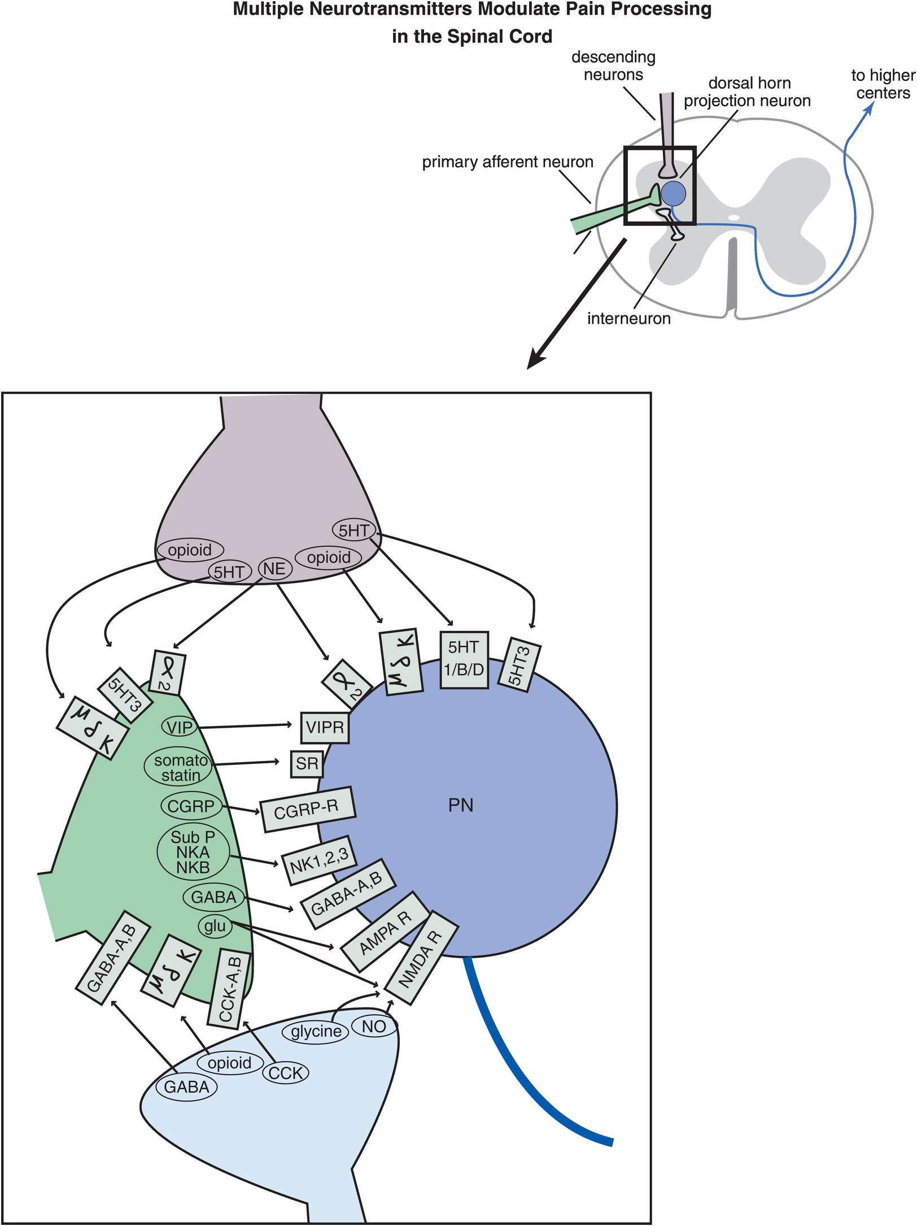

Slide 17
ADDICTION=REWARD-REINFORCEMENT
Controlled by Mu receptors
Ventral tegmental area (VTA) stimulates DA neurons
Nucleus Accumbens (NAC) releases DA: pleasure/desire
Orbitofrontal cortex: (OFC) value judgment/planning
Hippocampus: records the sensation as memory
Amigdala: imparts agreeable/disagreeable coloration
Insula: pleasure seeking
Locus Coruleus: NE alarm center: drives addict to seek relief

Slide 18
NEURAL PATHWAYS FOR ADDICTION
Disinhibition ( opioids , BZDs and cannabinoids)
Indirectly GABA A α 1 receptors disinhibit DA neurons
Direct depolarization of DA neurons ( Nicotine)
Activation of nicotinic receptors on ACH neurons
Blockade of Uptake ( Cocaine and Amphetamine)
Blockade of DAT
Forced release of DA in presynaptic vesicles: amphetamines
Tan et al: Nature 2010Feb 11, 463 (7282)

Slide 19
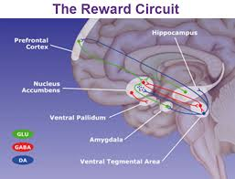

Slide 20
Nuclei that are involved in regulation of pleasure and ultimately addiction
wikipedia

Slide 21
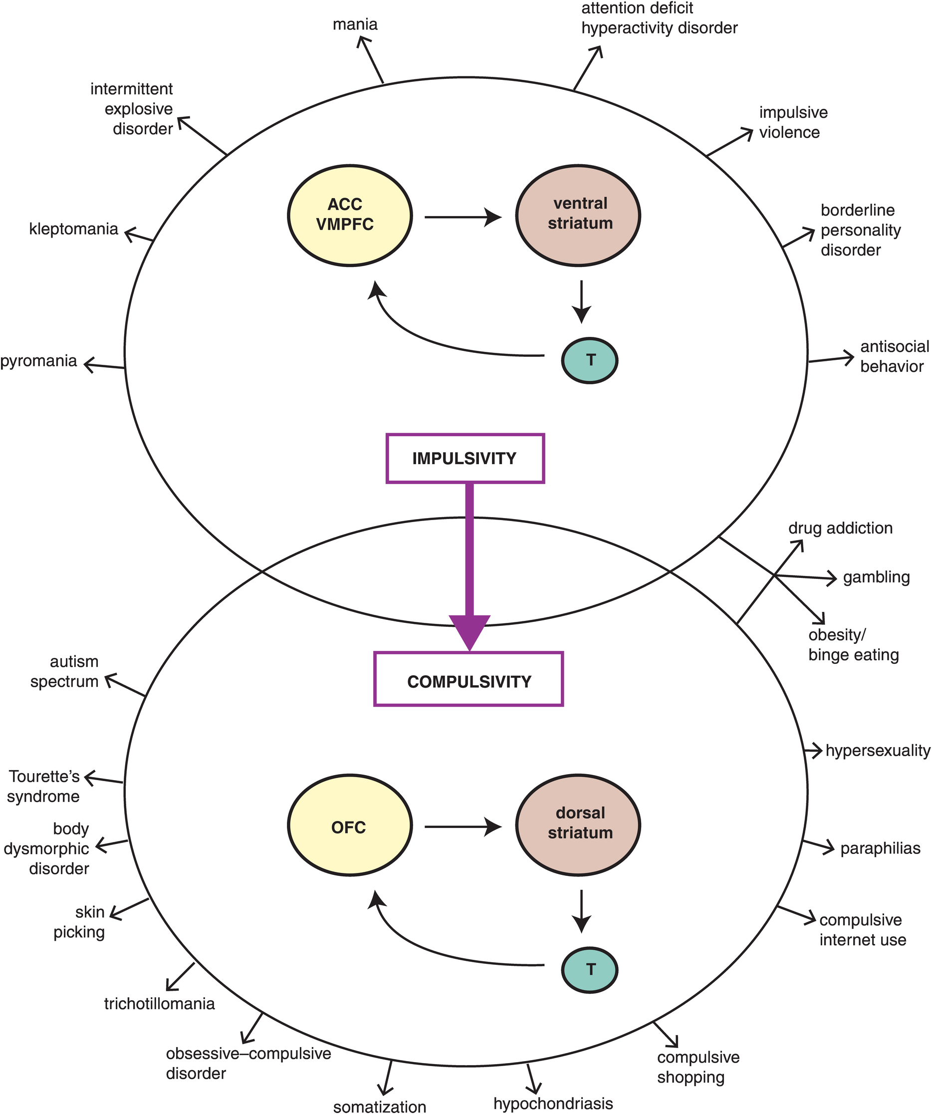

Slide 22
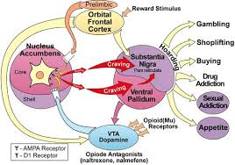

Slide 23
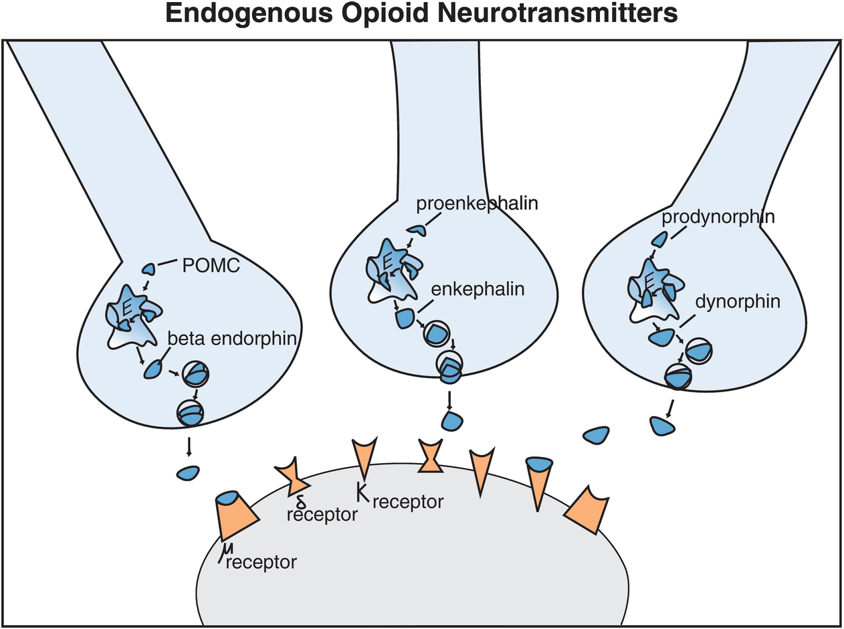

Slide 24
ADAPTATION: TOLERANCE & DEPENDENCE
OVER TIME RECEPTOR
Adapts to the opioid
Becomes less sensitive
Increase in the number of receptors

Slide 25
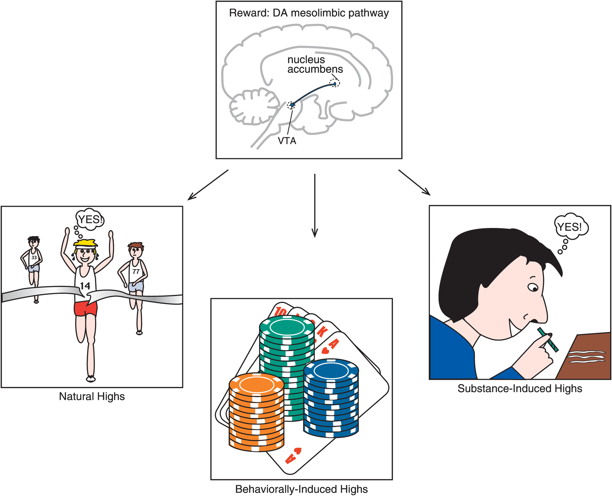

Slide 26
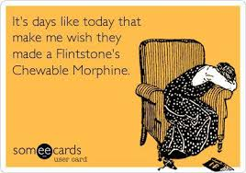

Slide 27
OPIOID AGONISTS/ANTAGONISTS
FULL AGONIST:
Fully activates Mu receptor
Highly reinforcing
Most abused opioid
Heroin, methadone, oxycodone etc
PARTIAL AGONISTS
Activates Mu receptor at lower levels
Less reinforcing
Buprenorphine
ANTAGONISTS
Occupies Mu receptor without activating
Blocks agonists from occupying sites
Naltrexone, naloxone

Slide 28
WITHDRAWAL SYNDROME
 | ONSET | PEAK | DURATION
HEROIN | 4-6 HOURS | ˜ 3 DAYS | 2-7 DAYS
METHADONE | 1-2 DAYS | ˜ 7 DAYS | 12-14 DAYS

Slide 29
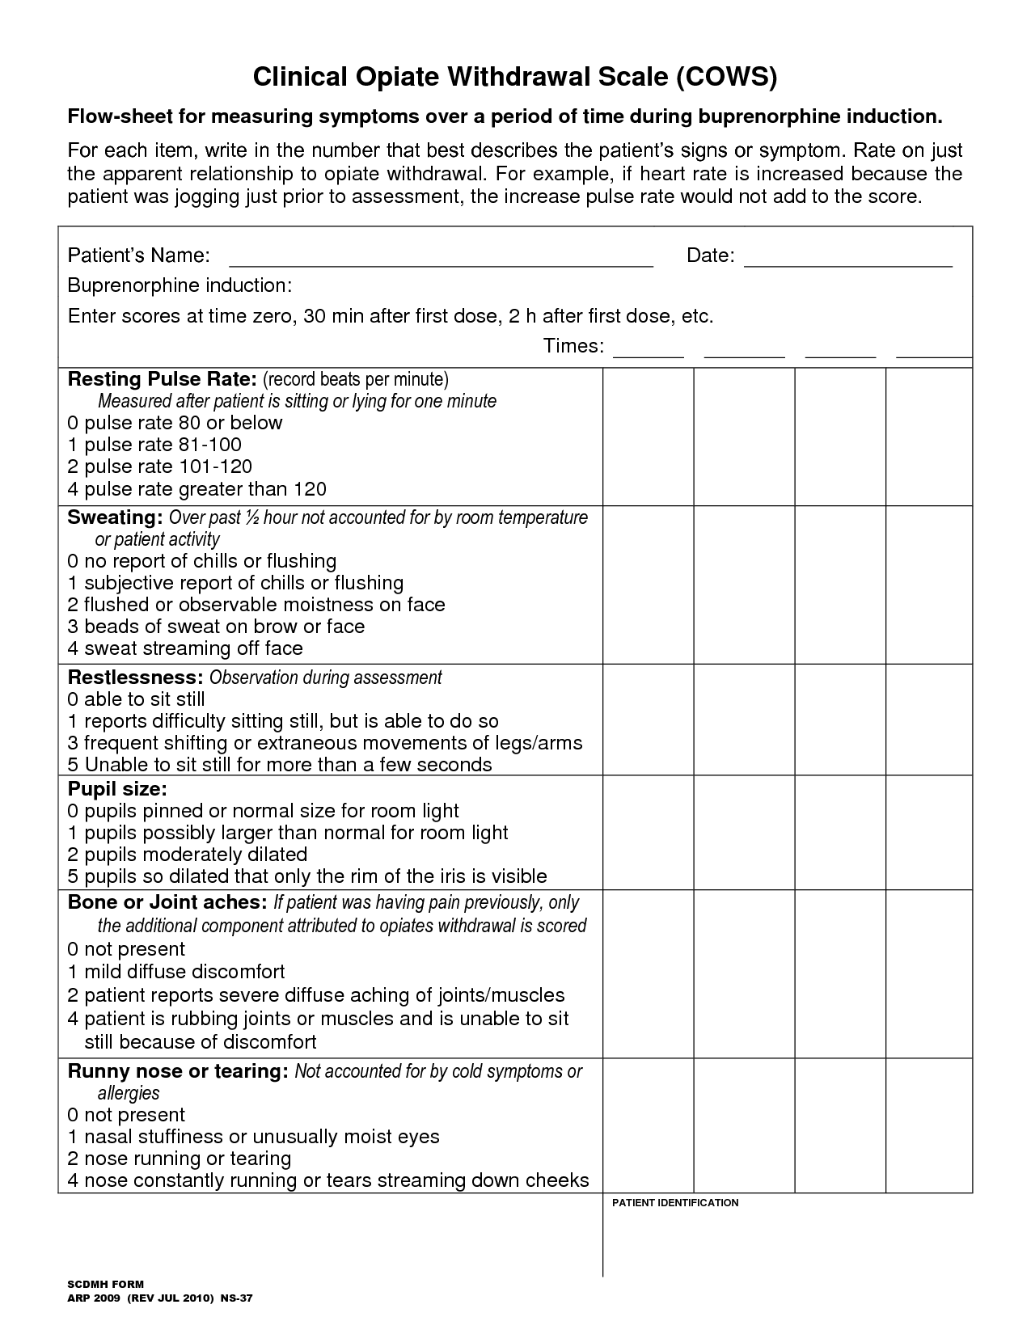

Slide 30
SUBOXONE
COMBINATION OF
BUPRENORPHINE
PARTIAL AGONIST ANTAGONIST OPIOID
SEMISYNTHETIC MANUFACTURED IN 1978 DERIVED FROM THEBAINE
SUBLINGUAL USE
HIGH AFFINITY FOR Mu RECEPTOR
STAYS ON RECEPTOR FOR LONG TIME
DISPLACES FULL AGONISTS SO COULD CAUSE PRECIPITATED WITHDRAWAL
NALOXONE
OPIOID ANTAGONIST
POORLY ABSORBED ORALLY
WILL PRECIPITATE WITHDRAWAL IF INJECTED

Slide 31
BUPRENEX
INJECTABLE BUPRENORPHINE
FDA APPROVED FOR MODERATE TO SEVERE PAIN
SCHEDULE 3
ILLEGAL TO USE FOR OPIOID DISORDERS

Slide 32
SUBUTEX
ORAL BUPRENORPHINE
ONLY APPROVED FOR OPIOID DISORDERS
LIMITED USE IN PREGNANCY AND ALLERGY TO SUBOXONE OR INDUCTION STRATEGIES

Slide 33
SUBOXONE BIOAVAILABILITY
ZERO IF SWALLOWED
GOOD FOR BUPRENORPHINE SUBLINGUALLY
ZERO FOR NALOXONE SUBLINGUALLY
GOOD FOR BOTH PARENTERALLY, BUT NALOXONE WILL BLOCK EARLY EFFECT OF BUPRENORPHINE

Slide 34
METABOLISM
CYP 3A4 TO NOR BUPRENORPHINE THE ACTIVE METABOLITE
BUP/NOR BUP ELIMINATED IN FECES AND URINE
MEAN HALF LIFE 37 HOURS
UDS
WILL NOT TEST POSITIVE FOR OPIATES
MUST ORDER BUP SCREEN TO CHECK COMPLIANCE
QUANTITATIVE BUP SCREENING TO MONITOR DIVERSION
NORBUP ALWAYS >BUP IF COMPLIANT

Slide 35
DOSING
BRAND AND GENERICS ON MARKET
FILM BRAND PRODUCT AND PREFERRED BY PATIENTS
GENERIC ONLY AVAILABLE IN VA
AVAILABLE IN TABLETS AND FILM
2/0.5MG AND 8/2 MG STRENGTHS

Slide 36
SAFETY
SAFETY RECORD ESTABLISHED
RARE FOR ALLERGIES TO DEVELOP
FEW SIDE EFFECTS: NAUSEA AND CONSTIPATION
NO EVIDENCE OF COGNITIVE IMPAIRMENT OR RESPIRATORY DEPRESSION
ORAL OVER DOSE HIGHLY FATAL
OVERDOSE WITH OTHER CNS DEPRESSANTS PROBLEMATIC
NO ABSOLUTE CONTRAINDICATION FOR USE WITH BZDS; HOWEVER VA DOES NOT ALLOW COMBINED USE
FEW CASES OF INJECTED SUBOXONE WITH OD ON BZDS
INJECTABLE FORM IS ROUTINELY ABUSED and ORAL SUBUTEX CAN BE CRUSHED AND INJECTED

Slide 37
INTERACTIONS
CYA 3A4 INHIBITORS CAN RAISE LEVELS
Prozac, Luvox, Tagamet, retrovirals
CYP 3A4 SUBSTRATES CAN RAISE LEVELS
Trazodone, Valium, Xanax, Oral Contraceptives, Ambien
CYP3A4 INDUCERS MAY LOWER LEVELS
Tegretol, PB, Dilantin, Mysoline, St John’s wort

Slide 38
CYP 1A2 /2B6 AND CIGARETTES
SMOKING INDUCES BOTH ENZYMES
METHADONE METABOLIZED BY THESE ENZYMES
METHADONE LEVELS MAY DROP AND ADDICTION MAY NOT BE WELL CONTROLLED
CESSATION OF SMOKING MAY RAISE LEVELS TO TOXIC POINT AND KILL THE PATIENT
FLIGHT INTO HEALTH MAY BE DEADLY

Slide 39
INDUCTION
NOT DONE AT CBOC DUE TO LACK OF SPACE , ACCESS TO PHARMACY AND NURSING STAFF
PATIENTS SENT TO INPT UNIT OR IN SOME INSTANCES TO IOP
TREATMENT AGREEMENT : SAMPLE FORMS AVAILABLE IN CPRS
PATIENT MUST BE IN WITHDRAWAL IN ORDER TO INITIATE
COWS SCORE 8 OR ABOVE
DO NOT RELY ON PT REPORT
UDS MUST BE DONE SAME DAY WITH REPORT
START WITH 4/1 AND MONITOR FOR 2 HOURS AND REASSESS
MAX DOSE IST DAY 8/2MG
IF WITHDRAWAL APPEARS IMMEDIATELY AFTER IST DOSE PRECIPITATE WITHDRAWAL IS LIKELY
FOR METHADONE START 24 HOURS AFTER LAST DOSE OR 48 WITH LAAM

Slide 40
INDUCTON : 2 ND DAY, STABILIZATION & WITHDRAWAL
INCREASE BY 2/0.5-4/1 MG UNTIL MAX DOSE 12/3-16/4
MAX DAILY DOSE 32/8MG
IF PT REPORTS PERSISTENCE OF WITHDRAWAL CHECK TO SEE IF SWALLOWING MEDICATION OR DIVERSION
MAINTENANCE DOSE GENERALLY NOT MORE THAN 24/6
INDEFINITE MAINTENANCE THE RULE AS 60-80% WILL RELAPSE WITHIN A YEAR
CAN DO RAPID (< 3 DAYS) OR SLOW
FEDERAL LAW REQUIRES COUNSELLING DURING TREATMENT

Slide 41
CERTIFICATION OF PRESCRIBERS
DATA 2000 IS THE LAW THAT AUTHORIZED USE OF SUBOXONE FOR OFFICE BASED TREATMENT
PRESCRIBERS WHO HAVE A VALID DEA CERTIFICATE MUST TAKE A 8 HOUR CERTIFICATION COURSE APPROVED BY SAMHSA
MUST OBTAIN SAMHSA WAIVER FOR THE FIRST 30 PATIENTS AND AFTER 1 YEAR FOR THE NEXT 70
VA MDS MUST BE CREDENTIALED
CAN ONLY USE THE WAIVER TO TREAT PATIENTS IN ONE OFFICE LOCATION IN ONE STATE

Slide 42
PITFALLS
NO TREATMENT AGREEMENT: MUST GO OVER IT SEVERAL TIMES
FAILURE TO DO COMPREHENSIVE PSYCHIATRIC ASSESSMENT INCLUDING SUBSTANCE USE EVALUATION
NOT MONITORING UDS WITH PERIODIC ADDITIONAL SCREENS FOR BUP/NORBUP, ALCOHOL AND OTHER OPIATES. MUST CHECK SP. GRAVITY AND TEMP OF URINE SAMPLE. VA UDS PROGRAM PATHETIC
NOT MONITORING THE PDMP ( E-FORCSE IN FLORIDA)
NOT MONITORING VITAL SIGNS AND METABOLIC PARAMETERS
POOR DOCUMENTATION
BEING DOGMATIC/PUNITIVE
NO COUNSELLING; NOT USING GROUP THERAPY FORMAT
USING SUBOXONE FOR PAIN MANAGEMENT
ABSENCE OF SUBSTANCE ABUSE PROGRAM OVERSIGHT IN NFSG
LACK OF SA CERTIFIED COUNSELLORS IN CBOCS

Slide 43
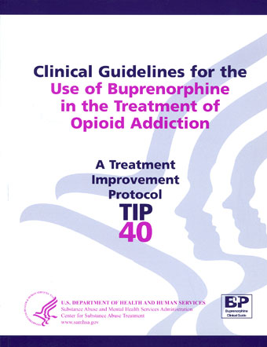
Substance Abuse Treatment
For Persons With
Co-Occurring Disorders
A Treatment
Improvement
Protocol
TIP
42
Substance Abuse
Treatment
For Persons
With
Co-Occurring
Disorders
A Treatment
Improvement
Protocol
TIP
42
U.S.
DEPARTMENT
OF
HEALTH
AND
HUMAN
SERVICES
Substance
Abuse
and
Mental
Health
Services
Administration
Center
for
Substance
Abuse
Treatment
1
Choke
Cherry
Road
Rockville,
MD
20857
Substance Abuse Treatment
For Persons With
Co-Occurring Disorders
A Treatment
Improvement
Protocol
TIP
42
Substance Abuse
Treatment
For Persons
With
Co-Occurring
Disorders
A Treatment
Improvement
Protocol
TIP
42
U.S.
DEPARTMENT
OF
HEALTH
AND
HUMAN
SERVICES
Substance
Abuse
and
Mental
Health
Services
Administration
Center
for
Substance
Abuse
Treatment
1
Choke
Cherry
Road
Rockville,
MD
20857

Slide 44
OTHER OPTIONS: TO BE DISCUSSED AT A LATER DATE
CLONIDINE
METHADONE
NALTREXONE
ORAL FORM: REVIA
LAI: VIVITROL

Slide 45
THE ST AUGUSTINE PROGRAM
STARTED IN 2013
ONE PRESCRIBER AND TO DATE 40 PATIENTS WITH 25 ACTIVE
HAS WEEKLY GROUP SESSIONS; EDUCATIONAL AND RELAPSE PREVENTION AND SUPPORTIVE APPROACH. NOT PUNITIVE
PATIENTS ASSIGNED TO OBJECTIVE LEVELS OF CARE WHICH ARE ADJUSTED AS THEY MAKE PROGRESS OR DETERIORATE
HIGH FUNCTION PATIENTS ARE SEEN EVERY 3 MONTHS IN INDIVIDUAL OR GROUP SESSION
HIGH RISK PATIENTS ARE SEEN WEEKLY AND REFERRED TO INDIVIDUAL COUNSELLING IN THE COMMUNITY OR IOP OR IN PT DETOX AND REHAB
RN ,ARNP. PHARMD AND MD ASSIGNED TO PROGRAM

Slide 46
LEVELS OF SUBOXONE CARE
LEVEL 1: UDS 1/MONTH AND MD VISIT EVERY 3 MONTHS
Criteria: full compliance, perfect attendance; high functioning; GAF >75
(GAF=Global Assessment of Function)
LEVEL 2: UDS/GROUP 1/MONTH : MD VISIT EVERY 3 MONTHS; IND COUNSELLING PRN
Criteria: full compliance; negative UDS for 12 months; 90% attendance; excellent ACTIVITIES of DAILY LIVING; no legal difficulties
LEVEL 3: ENTRY LEVEL: UDS/GROUP/MD ONCE OR TWICE/MONTH: IND COUNSELLING AS NEEDED
Criteria: discharge from hospital; recent abuse of illicits/medication; legal problems; other social impairment; affective, cognitive or psychotic symptoms

Slide 47
LEVEL 4: UDS/MD 1/WEEK; IOP; GROUP 2/MONTH; INDIVIDUAL COUNSELLING MANDATORY IF NOT IN IOP; UDS DONE WITH DIRECT OBSERVATION, RANDOM UDS
Criteria: non compliance; poor attendance; illicit drugs; use of prohibited meds; legal issues related to drugs such as DUI, possession , violence , MVA ,etc.
LEVEL 5: MANDATORY DETOX:
Criteria: repeated urine dilutions, used of illicits, alcohol or benzo abuse; legal issues such as drug or alcohol arrests, anything at level 4 or worse
LEVEL 6: DISMISSAL FROM PROGRAM:
Criteria: Diversion; urine negative for buprenrophine

Slide 48
THANKS TO
SAMHSA
NEVADA PSYCHIATRIC ASSOCIATION 2007 ANNUAL MEETING
JACKSONVILLE SAAT PROTOCOL: Michael Sorna MD
FARID, AYMAN MD, VAMC ATLANTA
Suboxone patients of St Augustine CBOC
Amy Cooper, Jill Saunders, Peggy Marion, Amanda Clarke
Wikipedia of course

